Slide 1
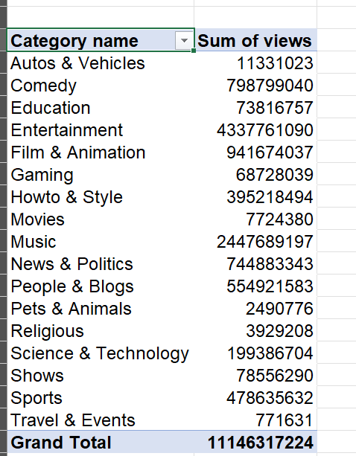
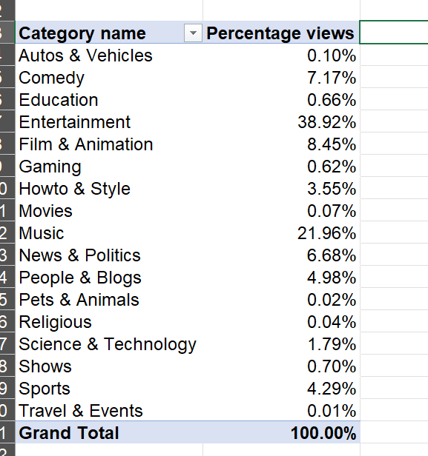
Task 9: category with percentage of views and sum of views

Slide 2
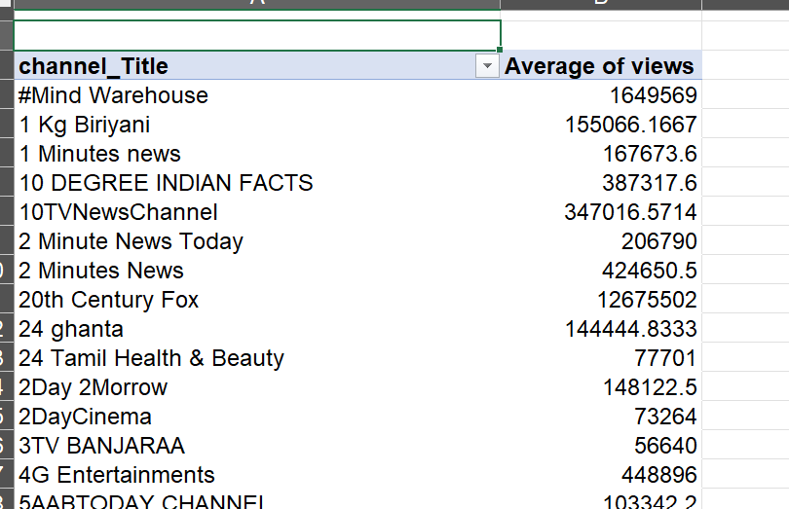
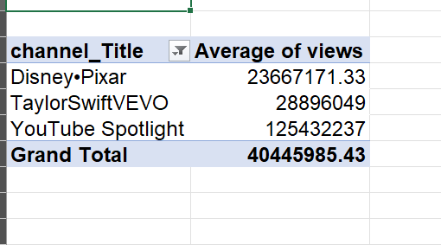
Task 10
Average views for all channels and top 3 channels with highest average

Slide 3
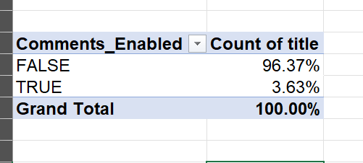
Task 11: percentage of videos based on comment status, enabled or disabled.

Slide 4
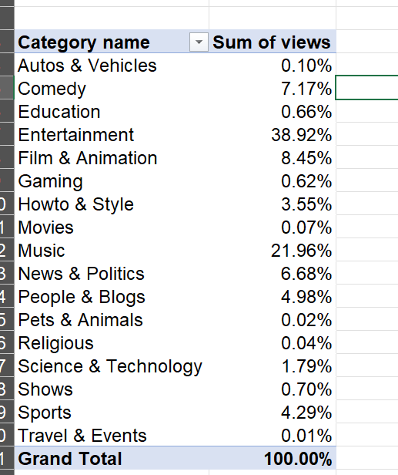
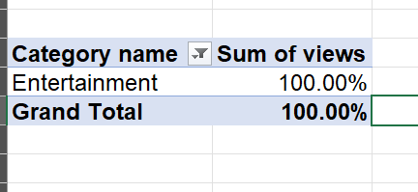
Task 12: percentage sum of views for all categories and name of category with highest sum %

Slide 5
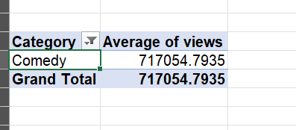
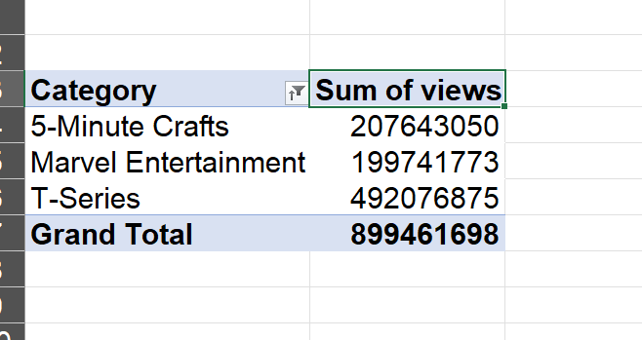
Task 13: average view of all channels with comedy category,
Top 3 channels with highest views

Slide 6
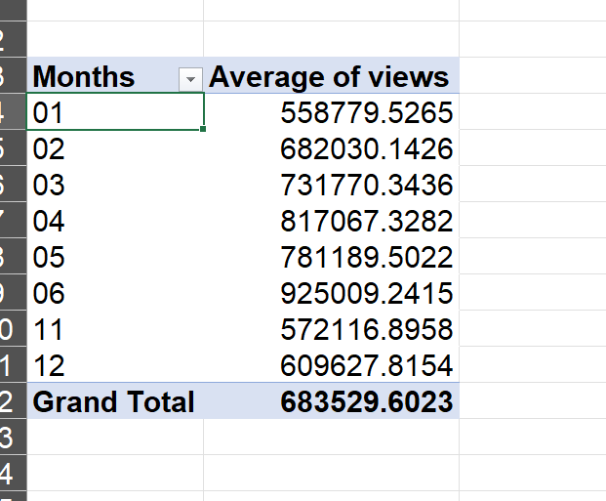
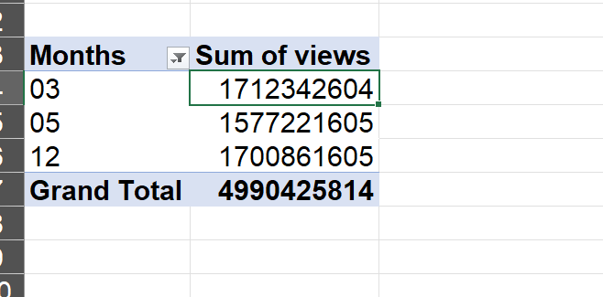
Task 14: average views per month
And top 3 months with highest sum of views

Slide 7
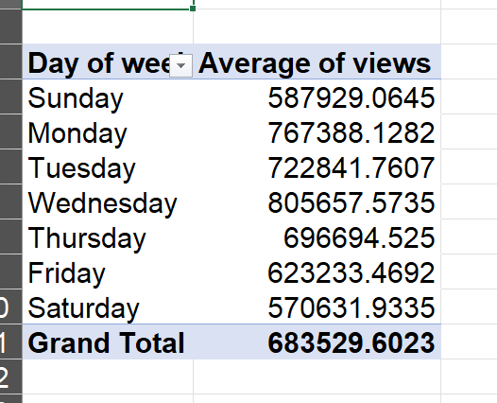
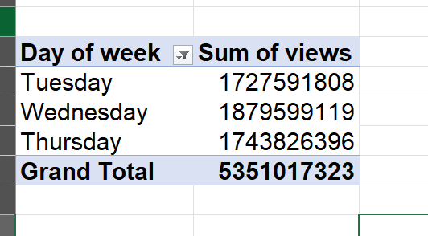
Task 15: Average vies based on day of week and top 3 days of week with highest no. of views

Slide 8
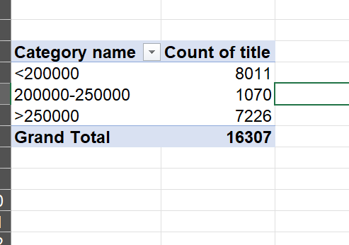
Task 16: Group the videos based on views and share views of group 200k-250k

